Slide 1
Project Scope Management

Slide 2
What is Project Scope Management?
Scope refers to everything that needs to be done in a project- the work, activities, and final results. It clearly defines what is included in the project and what is not included.
A deliverable is a product produced as part of a project, such as hardware or software, planning documents, or meeting minutes
Project scope management includes the processes involved in defining and controlling what is or is not included in a project

Slide 3
Project Scope Management Processes
Planning scope management: Create a scope management plan that explains how the scope will be defined, validated, and controlled.
Collecting requirements: defining and documenting the features and functions of the products produced during the project, as well as the processes used for creating them
Defining scope: reviewing the project charter, requirements documents, and organizational process assets to create a scope statement
Creating the WBS: subdividing the major project deliverables into smaller, more manageable components
Validating scope: formalizing acceptance of the project deliverables
Controlling scope: controlling changes to project scope throughout the life of the project

Slide 4
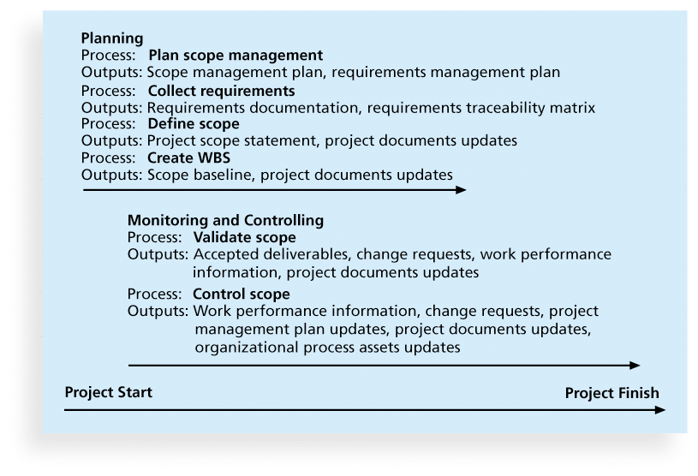
Project Scope Management Summary

Slide 5
Planning Scope Management
The project team uses expert judgment and meetings to develop two important outputs: the scope management plan and the requirements management plan
The scope management plan is a subsidiary part of the project management plan

Slide 6
Scope Management Plan Contents
How to prepare a detailed project scope statement
How to create a WBS
How to maintain and approve the WBS
How to obtain formal acceptance of the completed project deliverables
How to control requests for changes to the project scope

Slide 7
Requirements Management Plan
The PMBOK® Guide, Fifth Edition, describes requirements as “conditions or capabilities that must be met by the project or present in the product, service, or result to satisfy an agreement or other formally imposed specification”
The requirements management plan documents how project requirements will be analyzed, documented, and managed

Slide 8
Collecting Requirements
For some IT projects, it is helpful to divide requirements development into categories called:
Elicitation (ask and collect information),
Analysis (understand and organize what was collected),
Specification (documenting the requirements properly), and
Validation (Check and confirm with stakeholders.)
It is important to use an iterative approach to defining requirements since they are often unclear early in a project

Slide 9
Methods for Collecting Requirements
Interviewing
Focus groups and facilitated workshops
Questionnaires and surveys
Observation
Prototyping
Brainstorming
Benchmarking, or generating ideas by comparing specific project practices or product characteristics to those of other projects or products inside or outside the performing organization, can also be used to collect requirements

Slide 10
Requirements Traceability Matrix
A requirements traceability matrix (RTM) is a table that lists requirements, various attributes of each requirement, and the status of the requirements to ensure that all requirements are addressed
Table 5-1. Sample entry in an RTM
Requirement No. | Name | Category | Source | Status
R32 | Laptop memory | Hardware | Project charter and corporate laptop specifications | Complete. Laptops ordered meet requirement by having 4GB of memory.

Slide 11
Defining Scope
Project scope statements: A formal document that describes the project’s scope, deliverables, boundaries, assumptions, and constraints. It provides a common agreement among stakeholders about the project’s outcomes.
As time progresses, the scope of a project should become clearer and specific

Slide 12
Sample Project Charter (partial)
Project Title: Information Technology (IT) Upgrade project
Project Start Date: March 4 Project Finish Date: December 4
Key Schedule Milestones: Inventory update completed April 15 Hardware and software acquired August 1 Installation complete October 1 Testing complete November 15
Budget information: Budgeted $1,000,000 for hardware and software costs and $500,000 for labor costs.
Manager: Kim Nguyen, (310) 555- 2784, knguyen@course.com
Project objectives: Upgrade hardware and software for all employees (approximately 2,000) within nine months based on new corporate standards. See attached sheet describing the new standards. Upgrades may affect servers as well as associated network hardware and software.
Main Project Success Criteria: The hardware, software, and network upgrades must meet all written specifications, be thoroughly tested, and be completed in nine months. Employee work disruptions will be minimal.
Approach: Update the IT inventory database to determine upgrade needs. Develop detailed cost estimate for project and report to CIO Issue a request for quote to obtain hardware and software Use internal staff as much as possible for planning, analysis, and installation

Slide 13
Adding Project Scope
Project Charter: Upgrades may affect servers…(listed under Project Objective)
Project Scope Statement, Version 1: Servers: If additional servers are required to support this project, they must be compatible with existing servers. If it is more economical to enhance existing servers, a detailed description of enhancements must be submitted to the CIO for approval. See current server specifications provided in Attachment 6. The CEO must approve a detailed plan describing the servers and their location at least 2 weeks before installation.
Project Scope Statement, Version 2 Servers: This project will required purchasing ten new servers to support Web, network, database, applications and printing functions. Virtualization will be used to maximize efficient. Detailed descriptions of the servers are provided in a product brochure in Appendix 8 along with a plan describing where they will be located.

Slide 14
Creating the Work Breakdown Structure (WBS)
A Work Breakdown Structure (WBS) is a hierarchical breakdown of the total project work into smaller, manageable pieces.
Decomposition is subdividing project deliverables into smaller pieces
A work package is a task at the lowest level of the WBS
In simple words, WBS = Breaking the big project into smaller tasks until they are easy to manage.

Slide 15
Structure of WBS
Level 1: The overall project.
Level 2: Major deliverables or phases.
Level 3: Smaller components, sub-deliverables, or work packages.
Level 4 (and beyond): Detailed tasks if needed.

Slide 16
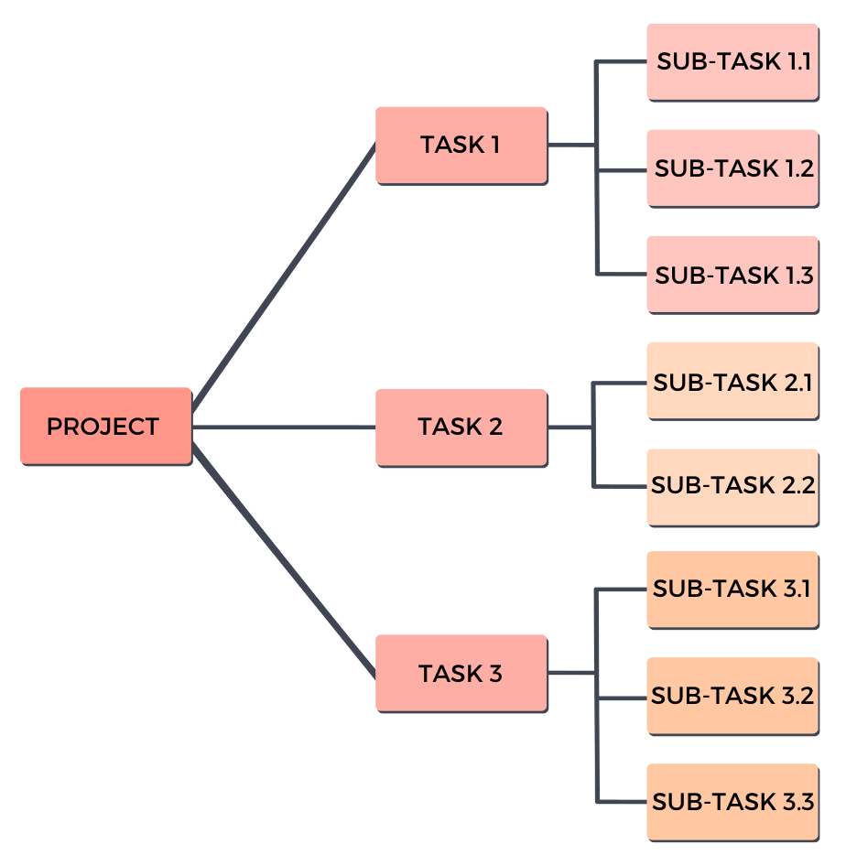
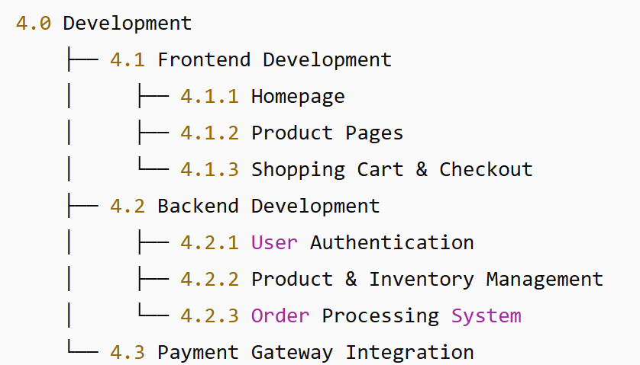
Work Breakdown Structure Example

Slide 17
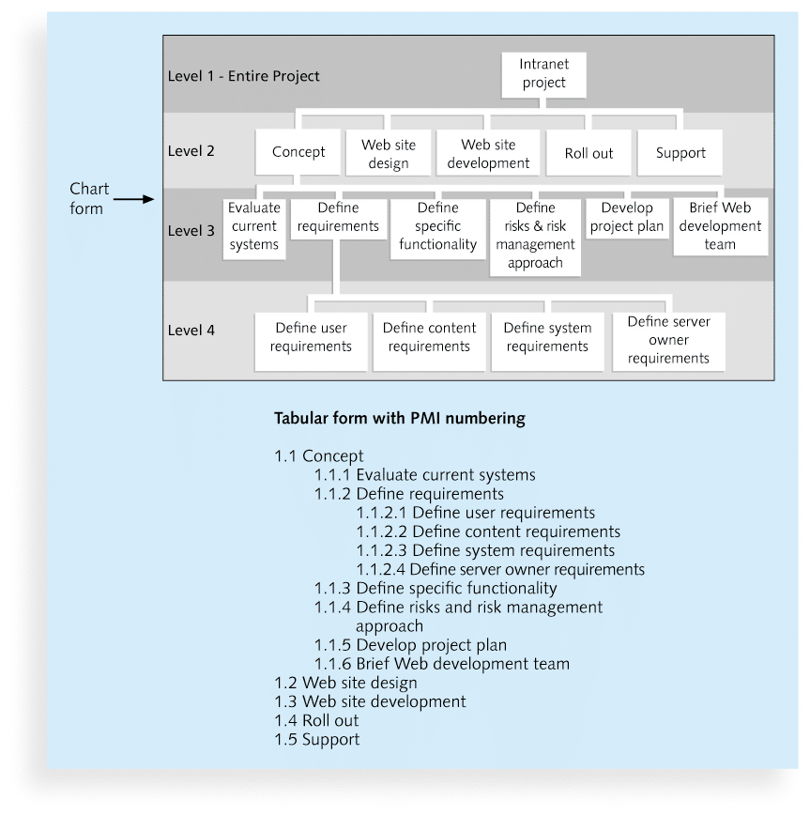
Sample Intranet WBS Organized by Phase

Slide 18
Approaches to Developing WBSs
Using guidelines: Some organizations, like the PMI (Project Management Institute), provide guidelines for preparing WBSs
The analogy approach: Review WBSs of similar projects and tailor to your project
The top-down approach: Start with the largest items of the project and break them down
The bottom-up approach: Start with the specific tasks and roll them up
Mind-mapping approach: Mind mapping is a technique that uses branches radiating out from a core idea to structure thoughts and ideas

Slide 19
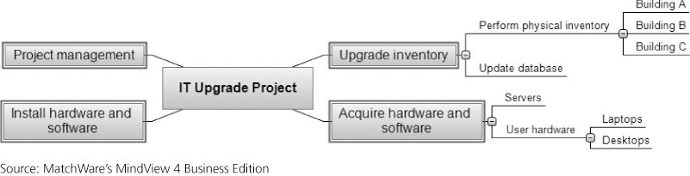
Sample Mind-Mapping Approach for Creating a WBS

Slide 20
The WBS Dictionary and Scope Baseline
Many WBS tasks are vague and must be explained more so that people know what to do and can estimate how long it will take and what it will cost to do the work
A WBS dictionary is a document that describes detailed information about each WBS item

Slide 21
Sample WBS Dictionary Entry
WBS Dictionary Entry March 20
Project Title: Information technology (IT) Upgrade Project
WBS Item Number: 2.2
WBS Item Name: Update Database
Description: The IT department maintains an online database of hardware and software on the corporate intranet. However, we need to make sure that we know exactly what hardware and software employees are currently using and if they have any unique needs before we decide what to order for the upgrade. This task will involve reviewing information from the current database, producing reports that list each department's employees and location, and updating the data after performing the physical inventory and receiving inputs from department managers. Our project sponsor will send a notice to all department managers to communicate the importance of this project and this particular task. In addition to general hardware and software upgrades, the project sponsors will ask the department managers to provide information for any unique requirements they might have that could affect the upgrades. This task also includes updating the inventory data for network hardware and software. After updating the inventory database, we will send an e-mail to each department manager to verify the information and make changes online as needed. Department managers will be responsible for ensuring that their people are available and cooperative during the physical inventory. Completing this task is dependent on WBS Item Number 2.1, Perform Physical Inventory, and must precede WBS Item Number 3.0, Acquire Hardware and Software.

Slide 22
Validating Scope
Validate Scope is the process of formalizing acceptance of the completed project deliverables.
Acceptance is often achieved by a customer inspection and then sign-off on key deliverables
Validating scope means checking deliverables with stakeholders, getting formal approval, and making sure the project is building exactly what was promised.

Slide 23
Controlling Scope
Scope control involves controlling changes to the project scope
Control Scope means keeping the project on track by only working on approved requirements, and carefully managing any requested changes.
Example (IT Project – Mobile App)
Scope baseline: App must have login, profile, and messaging features.
During execution, a stakeholder asks for “dark mode” (not in requirements).
Control Scope process:
Evaluate request.
Check impact on time, cost, resources.
Approve or reject formally.
Update documents if approved.

Slide 24
Summary
Project scope management includes the processes required to ensure that the project addresses all the work required, and only the work required, to complete the project successfully
Main processes include
Define scope management
Collect requirements
Define scope
Create WBS
Validate scope
Control scope

